Slide 1
FEMINIST DEMOCRATIC
REPRESENTATION
Karen Celis
Sarah Childs

Slide 2
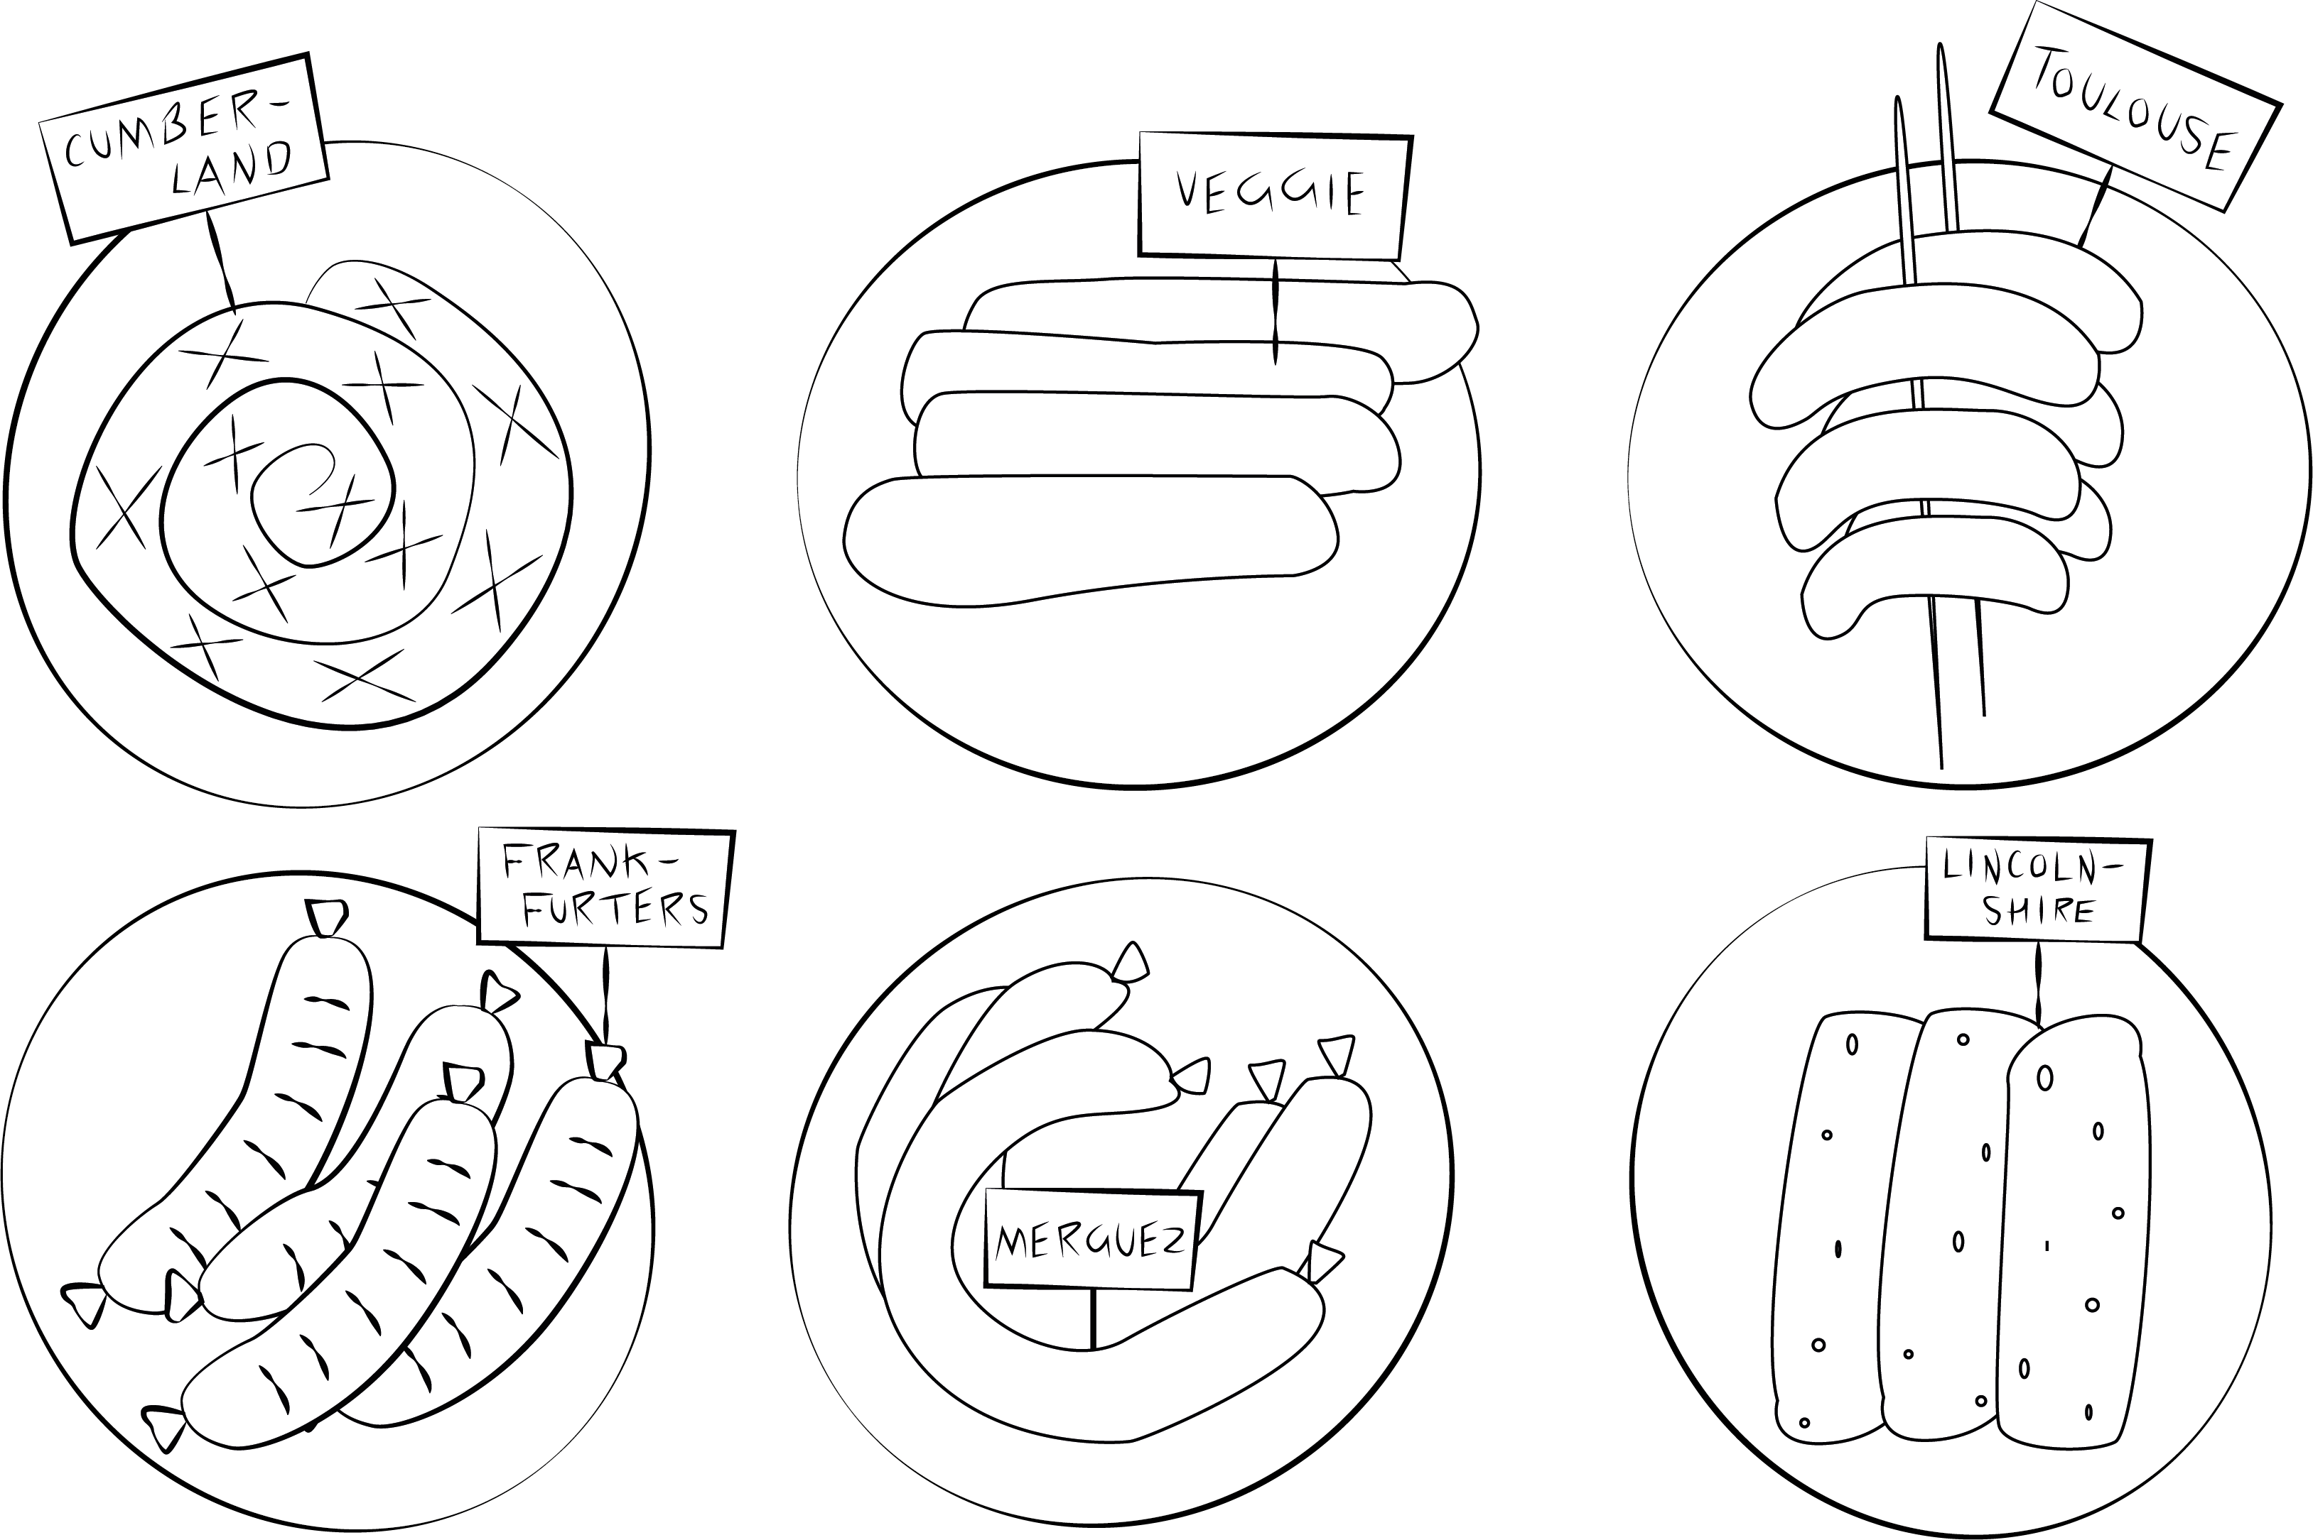

Slide 3
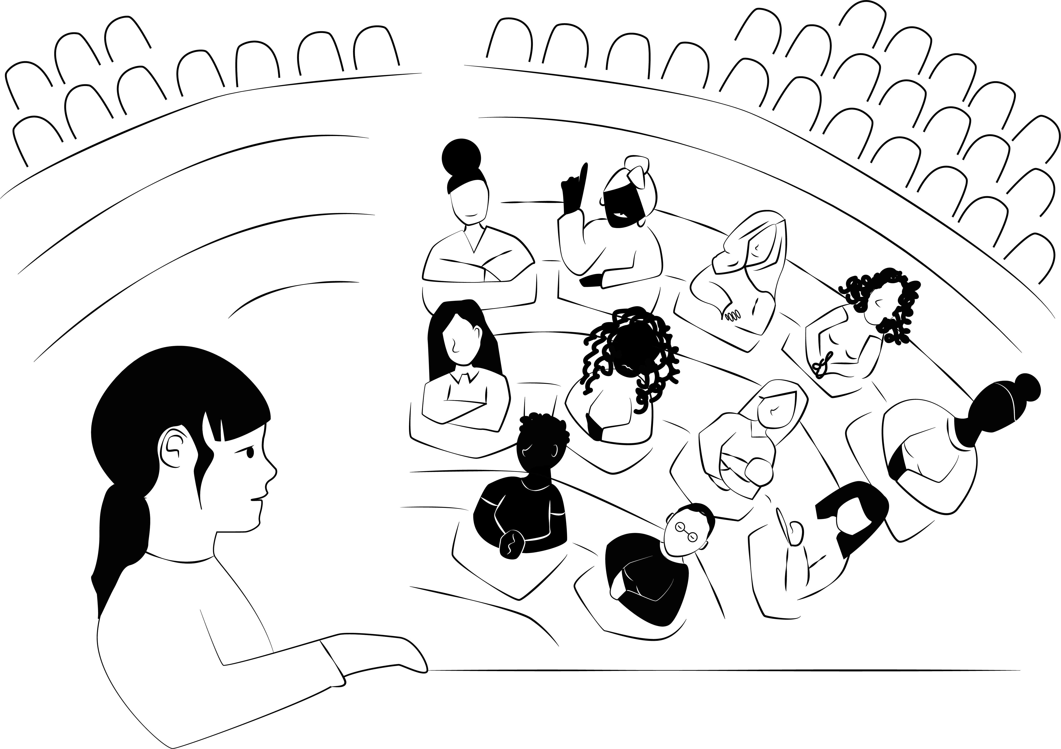

Slide 4
